Slide 1
Week 2 Scrum Master Presentation
Kyle Bartel

Slide 2
This Week - Coding Infrastructure
Spring Boot/Http/Docker setup
Java backend files created
Frontend development started
Everything is on time with our goals

Slide 3
Next Week - Preparation for Sprint 1 Demo
Complete frontend
Complete error checking and database interaction on the backend
Continue testing everything
Ensure frontend and backend is connected for the demo

Slide 4
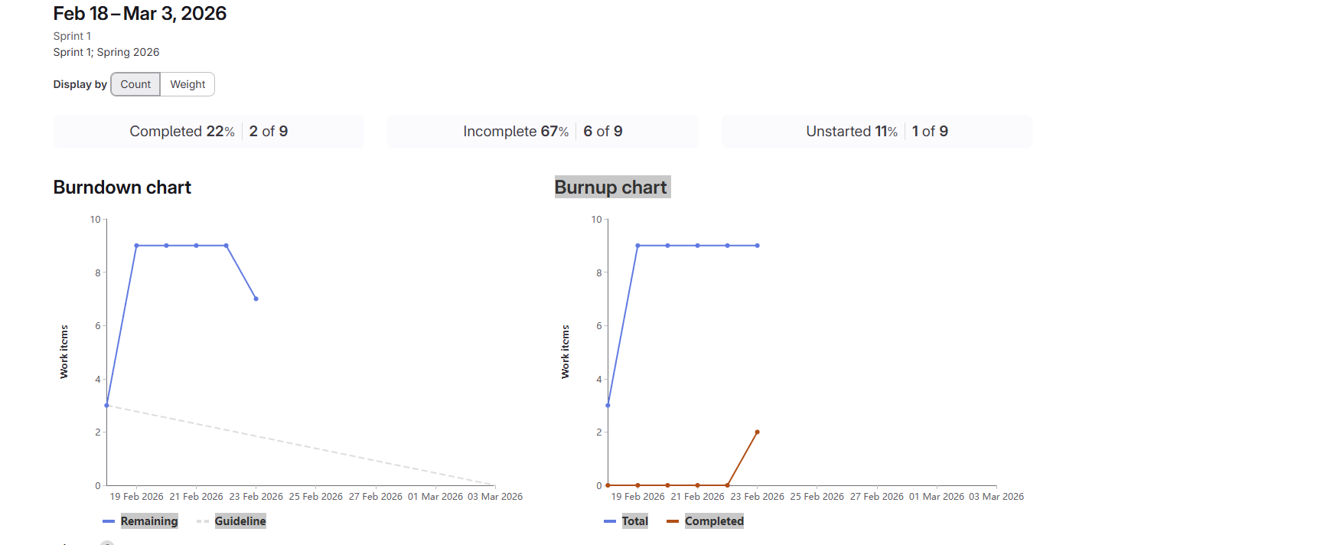
Statistics

Slide 5
Timeline
Wednesday - Technology stack fully integrated and verified
Sunday - Database backend completed and tested, connection proven
Monday - Demo

